Slide 1
Ebooks recommendation system using reviewer ratings
MCA Regular (3rd Year)
Final Semester Project
K.Sasi Kiran
2019202049
Guide
Ms.S.Kanimozhi,
Teaching Fellow

Slide 2
Overview
Domain:
Recommendation system

Slide 3
Problem Statement
The shortcomings of content based and collaborative based recommendation system are degrading the system.
The user satisfaction is very mere when these algorithms are being used.
More number of products are not been recommended, also they’re not efficient and faster.

Slide 4
Graph Learning based Recommender System (GLRS)
GLRS employ advanced graph learning approaches to model users' preferences and intentions as well as items' characteristics for recommendations.
Differently from other RS approaches, including content-based filtering and collaborative filtering, GLRS are built on graphs where the important objects, e.g., users, items, and attributes, are either explicitly or implicitly connected.

Slide 5
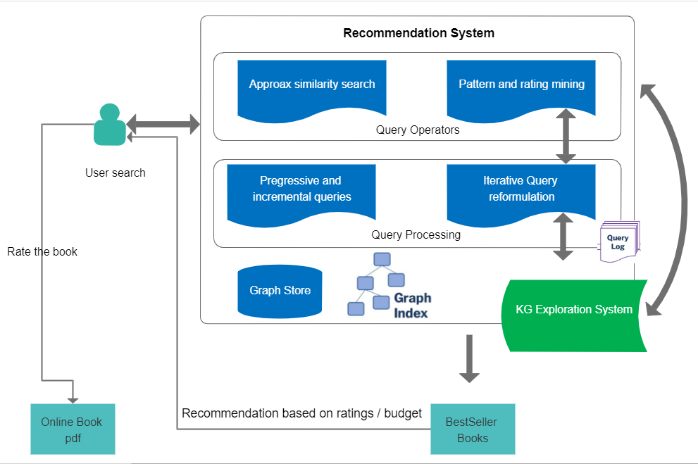
Architecture Diagram

Slide 6
Objective
The major objective of this project is to project how well a graph based system works in recommending products.
First the dataset is preprocessed; categorization, taking bestsellers out by manual analysis, book ratings.
On the dataset, graph based recommendation system is modelled.
Based on ratings and budget, the books are recommended and they are available for free online pdf copy.

Slide 7
FrameWork
Natural Language Processing
Machine Learning
Flask
Jupyter
Knowledge Graph
Neo4j

Slide 8
Module List
Data preprocessing
Develop UI
Graph learning recommender algorithm implementation.
Recommendation system.

Slide 9
Module Description
Data Extraction from Kaggle and preprocessing the data.
Building a flask based UI, where the user will give input as keywords in the search bar.
Graph based recommendation system is modelled upon the preprocessed dataset and efficient output is delivered.
The books are recommended, if the user wants to read the book online, they need to rate the book and continue to read online.

Slide 10
References
https://towardsdatascience.com/how-to-build-a-recommendation-system-in-a-graph-database-using-a-latent-factor-model-fa2d142f874
https://www.researchgate.net/publication/334795057_Information_Retrieval_Technology_Based_on_Knowledge_Graph
https://medium.com/analytics-vidhya/knowledge-graphs-an-overview-2d0d250dd3b9
https://medium.com/@benjburkholder/python-google-knowledge-graph-api-for-seo-c85c68d2fadd
https://schema.org/Book
http://snap.stanford.edu/class/cs224w-2017/projects/cs224w-58-final.pdf
https://arxiv.org/abs/2105.06339
https://dzone.com/articles/building-a-graph-based-recommendation-system

Slide 11
THANK YOU

